Slide 1

PIG

Slide 2
Pig is an Apache open source project. This means users are free to download it as source or binary, use it for themselves, contribute to it, and—under the terms of the Apache License—use it in their products and change it as they see fit.

Slide 3

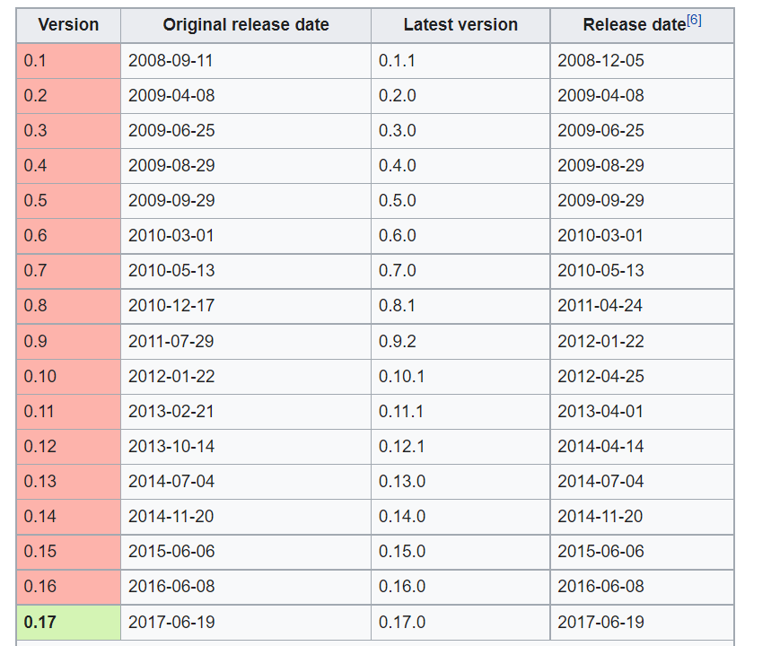

History:
Apache Pig was originally developed at Yahoo Research around 2006 for researchers to have an ad hoc way of creating and executing MapReduce jobs on very large data sets. In 2007, it was moved into the Apache Software Foundation.

Slide 4
Apache Pig – History
In 2006, Apache Pig was developed as a research project at Yahoo, especially to create and execute MapReduce jobs on every dataset.
In 2007, Apache Pig was open sourced via Apache incubator.
In 2008, the first release of Apache Pig came out.
In 2010, Apache Pig graduated as an Apache top-level project.

Slide 5
History
Pig was originally developed by Yahoo in 2006, for researchers to have an ad-hoc way of creating and executing MapReduce jobs on very large data sets.
In a MapReduce framework, programs need to be translated into a series of Map and Reduce stages. However, this is not a programming model which data analysts are familiar with. So, in order to bridge this gap, an abstraction called Pig was built on top of Hadoop.
It was created to reduce the development time through its multi-query approach.
Pig is also created for professionals from non-Java background, to make their job easier.

Slide 6
Apache Pig is an abstraction over MapReduce. Apache Pig is a platform for analyzing large data sets that consists of a high-level language for expressing data analysis programs, coupled with infrastructure for evaluating these programs.
Apache Pig is a high-level platform for creating programs that run on Apache Hadoop.
Pig can execute its Hadoop jobs in MapReduce, Apache Tez, or Apache Spark.
To write data analysis programs, Pig provides a high-level language known as Pig Latin. This language provides various operators using which programmers can develop their own functions for reading, writing, and processing data.
Pig Latin can be extended using user-defined functions (UDFs) which the user can write in Java, Python, JavaScript, Ruby or Groovy and then call directly from the language

Slide 7
Need for Apache Pig
Programmers who are not so good at Java normally used to struggle working with Hadoop, especially while performing any MapReduce tasks.
Using Pig Latin, programmers can perform MapReduce tasks easily without having to type complex codes in Java.
Apache Pig uses multi-query approach, thereby reducing the length of codes. For example, an operation that would require you to type 200 lines of code (LoC) in Java can be easily done by typing as less as just 10 LoC in Apache Pig. Ultimately Apache Pig reduces the development time by almost 16 times.
Pig Latin is SQL-like language and it is easy to learn Apache Pig when you are familiar with SQL.
Apache Pig provides many built-in operators to support data operations like joins, filters, ordering, etc. In addition, it also provides nested data types like tuples, bags, and maps that are missing from MapReduce.

Slide 8
Applications of Apache Pig:
Apache Pig is generally used by data scientists for performing tasks involving ad-hoc processing and quick prototyping. Apache Pig is used −
To process huge data sources such as web logs.
To perform data processing for search platforms.
To process time sensitive data loads.

Slide 9
Features of Pig
Apache Pig comes with the following features −
Rich set of operators − It provides many operators to perform operations like join, sort, filer, etc.
Ease of programming − Pig Latin is similar to SQL and it is easy to write a Pig script if you are good at SQL.
Optimization opportunities − The tasks in Apache Pig optimize their execution automatically, so the programmers need to focus only on semantics of the language.
Extensibility − Using the existing operators, users can develop their own functions to read, process, and write data.
UDF’s − Pig provides the facility to create User-defined Functions in other programming languages such as Java and invoke or embed them in Pig Scripts.
Handles all kinds of data − Apache Pig analyzes all kinds of data, both structured as well as unstructured. It stores the results in HDFS.

Slide 10
Advantage of apache PIG
Less code - The Pig consumes less line of code to perform any operation.
Reusability - The Pig code is flexible enough to reuse again.
Nested data types - The Pig provides a useful concept of nested data types like tuple, bag, and map.

Slide 11
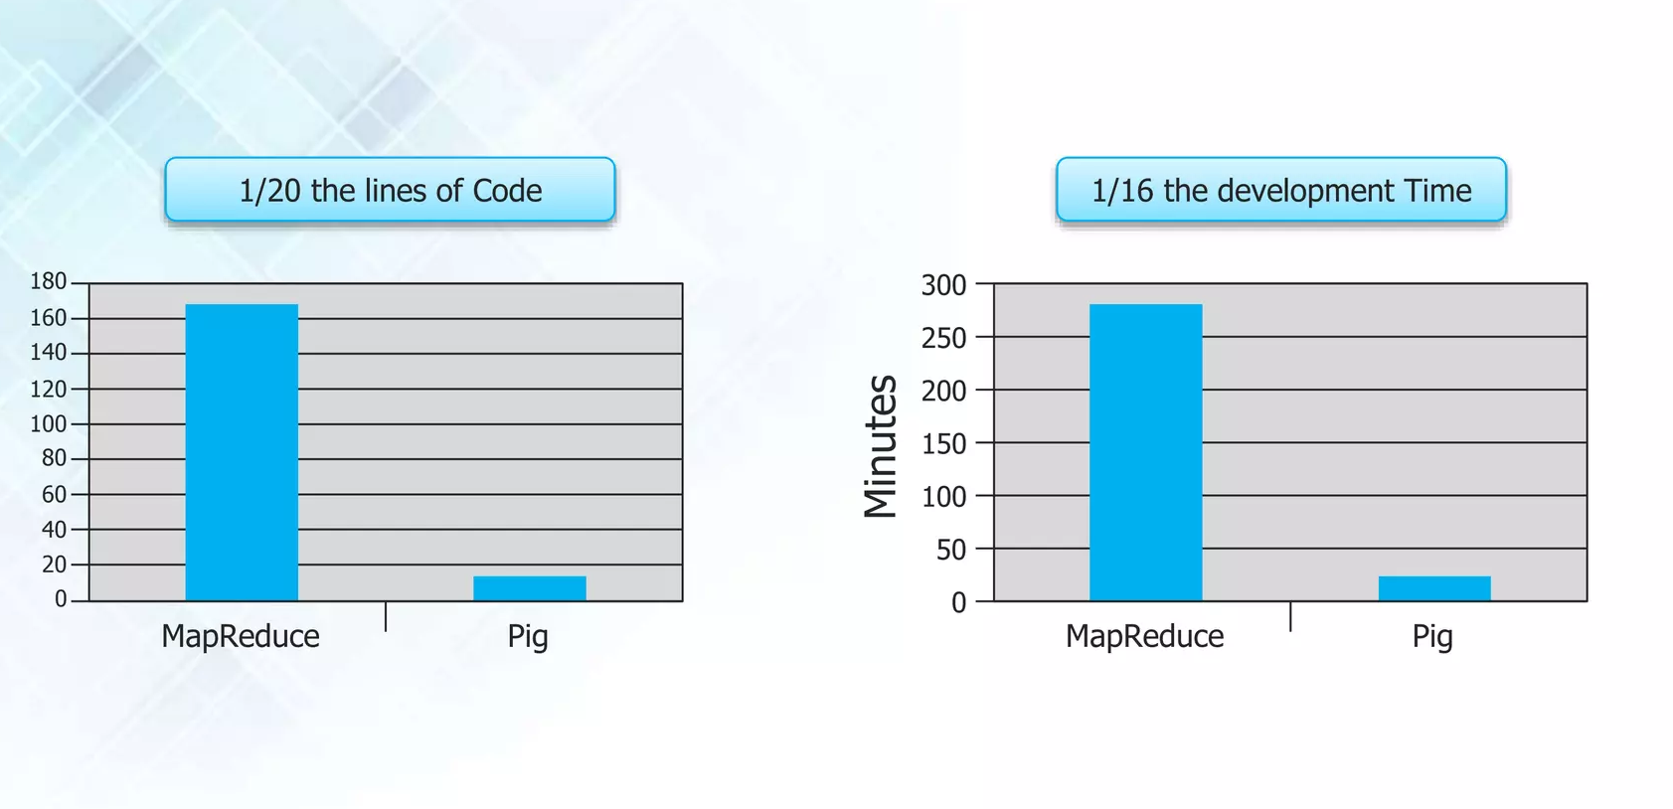

Slide 12
Features of Pig Hadoop
There are several features of Apache Pig:
In-built operators: Apache Pig provides a very good set of operators for performing several data operations like sort, join, filter, etc.
Ease of programming: Since Pig Latin has similarities with SQL, it is very easy to write a Pig script.
Automatic optimization: The tasks in Apache Pig are automatically optimized. This makes the programmers concentrate only on the semantics of the language.
Handles all kinds of data: Apache Pig can analyze both structured and unstructured data and store the results in HDFS.

Slide 13
Apache Pig Vs MapReduce
Listed below are the major differences between Apache Pig and MapReduce.
Apache Pig | MapReduce
Apache Pig is a data flow language. | MapReduce is a data processing paradigm.
It is a high level language. | MapReduce is low level and rigid.
Performing a Join operation in Apache Pig is pretty simple. | It is quite difficult in MapReduce to perform a Join operation between datasets.
Any novice programmer with a basic knowledge of SQL can work conveniently with Apache Pig. | Exposure to Java is must to work with MapReduce.
Apache Pig uses multi-query approach, thereby reducing the length of the codes to a great extent. | MapReduce will require almost 20 times more the number of lines to perform the same task.
There is no need for compilation. On execution, every Apache Pig operator is converted internally into a MapReduce job. | MapReduce jobs have a long compilation process.

Slide 14
Apache Pig vs SQL
Pig | SQL
Pig Latin is a procedural language. | SQL is a declarative language.
In Apache Pig, schema is optional. We can store data without designing a schema values are stored as $01,$02 etc. | Schema is mandatory in SQL.
The data model in Apache Pig is nested relational. | The data model used in SQL is flat relational.
Apache Pig provides limited opportunity for Query optimization. | There is more opportunity for query optimization in SQL.

Slide 15
Applications of Apache Pig
Apache Pig is generally used by data scientists for performing tasks involving ad-hoc processing and quick prototyping.
Apache Pig is used −
To process huge data sources such as web logs.
To perform data processing for search platforms.
To process time sensitive data loads.

Slide 16
I Install PIG
To install pig
untar the .gz file using tar –xvzf pig-0.13.0-bin.tar.gz
To initialize the environment variables, export the following:
export PIG_HADOOP_VERSION=20 (Specifies the version of hadoop that is running)
export HADOOP_HOME=/home/(user-name)/hadoop-0.20.2 (Specifies the installation directory of hadoop to the environment variable HADOOP_HOME. Typically defined as /home/user-name/hadoop-version)
export PIG_CLASSPATH=$HADOOP_HOME/conf (Specifies the class path for pig)
export PATH=$PATH:/home/user-name/pig-0.13.1/bin (for setting the PATH variable)
export JAVA_HOME=/usr (Specifies the java home to the environment variable.)

Slide 17
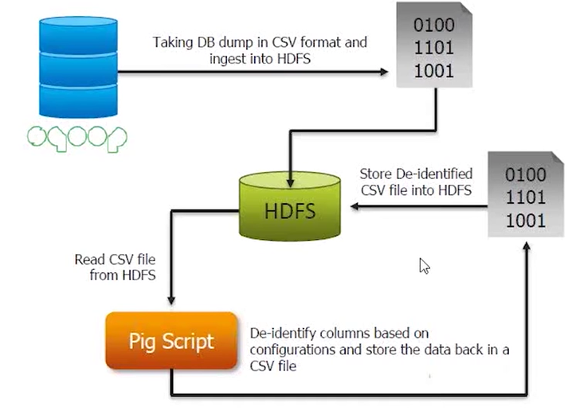
PIG Use Case

Slide 18
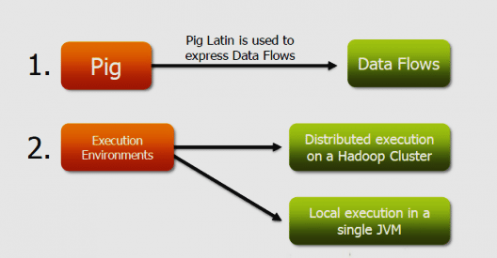
Components of Pig:

Slide 19
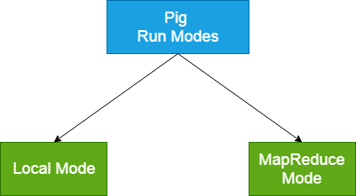
Apache Pig Run Modes
Apache Pig executes in two modes: Local Mode and MapReduce Mode.
Pig in Local mode
No HDFS is required, All files run on local file system.
Command: pig –x local
Pig in MapReduce(hadoop) mode
To run PIG scripts in MR mode, ensure you have access to HDFS, By Default, PIG starts in MapReduce Mode.
Command: pig –x mapreduce or pig

Slide 20
PIG Program Structure
Grunt Shell or Interactive mode
Grunt is an interactive shell for running PIG commands.
PIG Scripts or Batch mode
PIG can run a script file that contains PIG commands.
E.g. PIG script.pig

Slide 21
Ways to execute Pig Program
These are the following ways of executing a Pig program on local and MapReduce mode: -
Interactive Mode - In this mode, the Pig is executed in the Grunt shell. To invoke Grunt shell, run the pig command. Once the Grunt mode executes, we can provide Pig Latin statements and command interactively at the command line.
Batch Mode - In this mode, we can run a script file having a .pig extension. These files contain Pig Latin commands.
Embedded Mode - In this mode, we can define our own functions. These functions can be called as UDF (User Defined Functions). Here, we use programming languages like Java and Python.

Slide 22
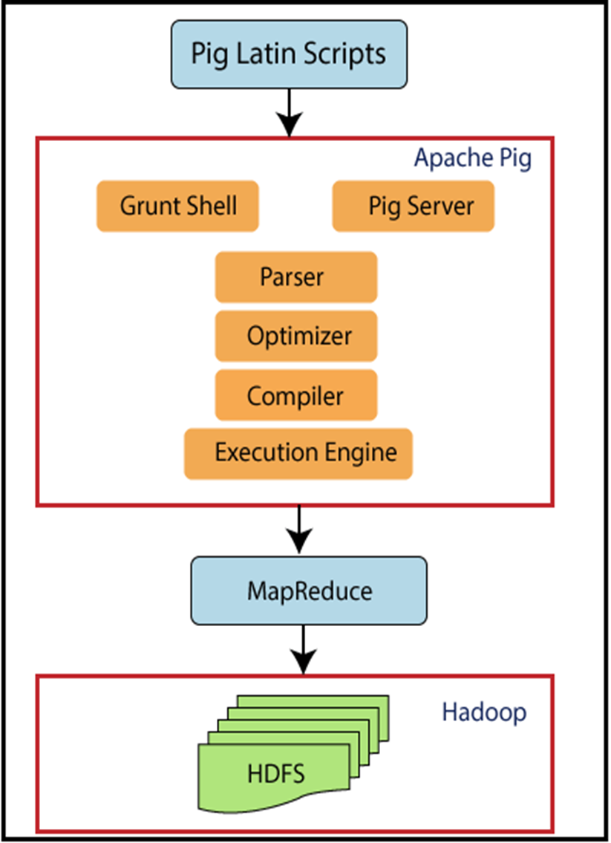
PIG ARCHITECTURE
Hadoop Pig is nothing
but an abstraction over
MapReduce.
Generally, we use it with
Hadoop. By using Pig,
we can perform all the
data manipulation
operations in Hadoop.

Slide 23
The language used to analyse data in Hadoop using Pig is known as Pig Latin.
It is a high-level data processing language which provides a rich set of data types and operators to perform various operations on the data.
To perform a particular task using Pig, programmers need to write a Pig script using the Pig Latin language, and execute them using any of the execution mechanisms (Grunt Shell, UDFs, Embedded).
After execution, these scripts will go through a series of transformations applied by the Pig Framework, to produce the desired output.
Internally, Apache Pig converts these scripts into a series of MapReduce jobs, and thus, it makes the programmer’s job easy. The architecture of Apache Pig is shown below.

Slide 24
Apache Pig Components
As shown in the figure, there are various components in the Apache Pig framework.
Parser
Initially the Pig Scripts are handled by the Parser. It checks the syntax of the script, does type checking, and other miscellaneous checks. The output of the parser will be a DAG (directed acyclic graph), which represents the Pig Latin statements and logical operators.
In the DAG, the logical operators of the script are represented as the nodes and the data flows are represented as edges.
Optimizer
The logical plan (DAG) is passed to the logical optimizer, which carries out the logical optimizations such as projection and pushdown.

Slide 25
Compiler
The compiler compiles the optimized logical plan into a series of MapReduce jobs.
Execution engine
Finally the MapReduce jobs are submitted to Hadoop in a sorted order.
Finally, these MapReduce jobs are executed on Hadoop producing the desired results.

Slide 26
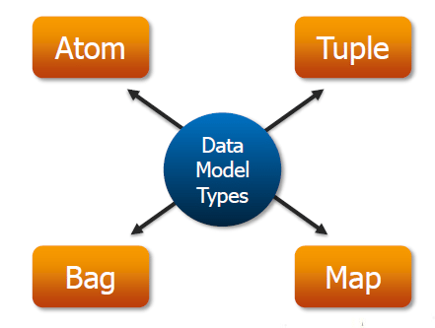

Slide 27
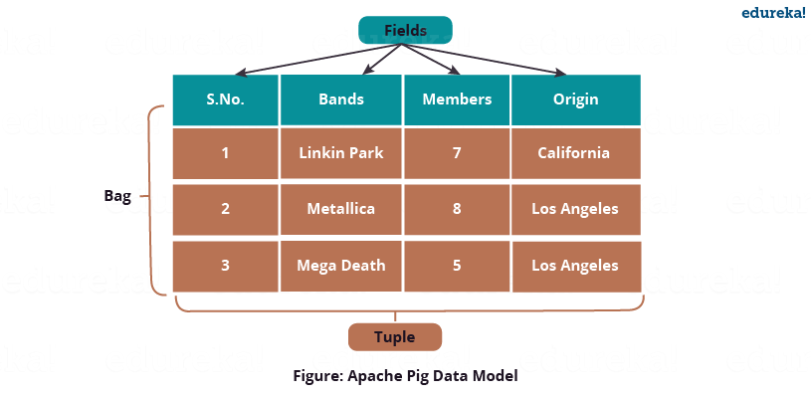
Pig Latin Data Model
The data model of Pig Latin is fully nested and it allows complex non-atomic datatypes such as map and tuple.
Atomic /Scalar Data type
Atomic or scalar data types are the basic data types which are used in all the languages like string, int, float, long, double, char[], byte[]. These are also called the primitive data types.
The value of each cell in a field (column) is an atomic data type.

Slide 28
For fields, positional indexes are generated by the system automatically (also known as positional notation), which is represented by ‘$’ and it starts from $0, and grows $1, $2, so on… As compared with the below image $0 = S.No., $1 = Bands, $2 = Members, $3 = Origin.
Scalar data types are − ‘1’, ‘Linkin Park’, ‘7’, ‘California’ etc.

Slide 29
Tuple
Tuple is an ordered set of fields which may contain different data types for each field. You can understand it as the records stored in a row in a relational database.
A Tuple is a set of cells from a single row.
The elements inside a tuple does not necessarily need to have a schema attached to it.
A tuple is represented by ‘()’ symbol.
Example of tuple − (1, Linkin Park, 7, California)
Since tuples are ordered, we can access fields in each tuple using indexes of the fields, like $1 form above tuple will return a value ‘Linkin Park’.
tuple doesn’t have any schema attached to it.

Slide 30
Bag
A bag is a collection of a set of tuples and these tuples are subset of rows or entire rows of a table. A bag can contain duplicate tuples, and it is not mandatory that they need to be unique.
The bag has a flexible schema i.e. tuples within the bag can have different number of fields. A bag can also have tuples with different data types.
A bag is represented by ‘{}’ symbol.
Example of a bag − {(Linkin Park, 7, California), (Metallica, 8), (Mega Death, Los Angeles)}
But for Apache Pig to effectively process bags, the fields and their respective data types need to be in the same sequence.

Slide 31
Set of bags −
{(Linkin Park, 7, California), (Metallica, 8), (Mega Death, Los Angeles)},
{(Metallica, 8, Los Angeles), (Mega Death, 8), (Linkin Park, California)}
There are two types of Bag, i.e. Outer Bag or relations and Inner Bag.

Slide 32
Outer bag or relation is nothing but a bag of tuples. Here relations are similar as relations in relational databases. To understand it better let us take an example:
{(Linkin Park, California), (Metallica, Los Angeles), (Mega Death, Los Angeles)}
This above bag explains the relation between the Band and their place of Origin.
On the other hand, an inner bag contains a bag inside a tuple. For Example, if we sort Band tuples based on Band’s Origin, we will get:
(Los Angeles, {(Metallica, Los Angeles), (Mega Death, Los Angeles)})
(California,{(Linkin Park, California)})
Here, first field type is a string while the second field type is a bag, which is an inner bag within a tuple.

Slide 33
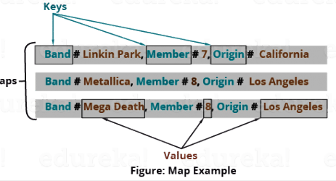
Map
A map is key-value pairs used to represent data elements. The key must be a chararray [] and should be unique like column name, so it can be indexed and value associated with it can be accessed on basis of the keys. The value can be of any data type.
Maps are represented by ‘[]’ symbol and key-value are separated by ‘#’ symbol, as you can see in the above image.
Example of maps− [band#Linkin Park, members#7 ], [band#Metallica, members#8 ]

Slide 34
Relation
A relation is a bag of tuples. The relations in Pig Latin are unordered (there is no guarantee that tuples are processed in any particular order).
The data model of Pig is fully nested. A Relation is the outermost structure of the Pig Latin data model.
A bag is a collection of tuples.
A tuple is an ordered set of fields.
A field is a piece of data.

Slide 35
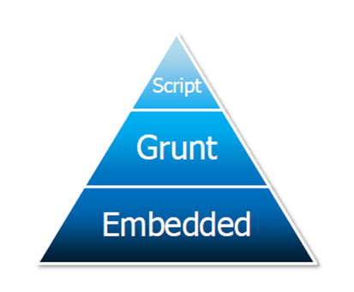
Pig Latin Scripts
Initially, we submit the Pig scripts written in Pig Latin to the Apache Pig execution environment. There are three ways of executing the Pig script:
Grunt Shell: It is the Apache Pig’s interactive shell for executing all the Pig Scripts.
Pig Server: We can write all the Pig commands in the script file and then execute the Pig script file. Pig Server executes this script file.
Embedded Script: We can create UDF by using languages like Java, Ruby, Python, etc. if some functions are unavailable. This UDF is embedded in the Pig Latin Script file, and then the script file is executed.

Slide 36
Complex Data Types
Type | Description
Tuple | Ordered set of fields (a “row / record”)
Bag | Collection of tuples (a “resultset / table”)
Map | A set of key-value pairs Keys must be of type chararray

Slide 37
Pig Data Formats
BinStorage
Loads and stores data in machine-readable (binary) format
PigStorage
Loads and stores data as structured, field delimited text files
TextLoader
Loads unstructured data in UTF-8 format
PigDump
Stores data in UTF-8 format
YourOwnFormat!
via UDFs

Slide 38
Shell Commands
The Grunt shell of Apache Pig is mainly used to write Pig Latin scripts. Prior to that, we can invoke any shell commands using sh and fs.
sh Command
Using sh command, we can invoke any shell commands from the Grunt shell. Using sh command from the Grunt shell, we cannot execute the commands that are a part of the shell environment (ex − cd).
Syntax
Given below is the syntax of sh command.
grunt> sh shell command parameters
Example
We can invoke the ls command of Linux shell from the Grunt shell using the sh option as shown below. In this example, it lists out the files in the /pig/bin/ directory.
grunt> sh ls
pig
pig_1444799121955.log
pig.cmd pig.py

Slide 39
fs Command
Using the fs command, we can invoke any FsShell commands from the Grunt shell.
Syntax
syntax of fs command.
grunt> sh File System command parameters
Example
We can invoke the ls command of HDFS from the Grunt shell using fs command. In the following example, it lists the files in the HDFS root directory.
grunt> fs –ls
Found 3 items
drwxrwxrwx - Hadoop supergroup 0 2015-09-08 14:13 Hbase
drwxr-xr-x - Hadoop supergroup 0 2015-09-09 14:52 seqgen_
data drwxr-xr-x - Hadoop supergroup 0 2015-09-08 11:30 twitter_data
In the same way, we can invoke all the other file system shell commands from the Grunt shell using the fs command.

Slide 40
Pig Latin – Statemets
While processing data using Pig Latin, statements are the basic constructs.
These statements work with relations. They include expressions and schemas.
Every statement ends with a semicolon (;).
Except LOAD and STORE, while performing all other operations, Pig Latin statements take a relation as input and produce another relation as output.
As soon as you enter a Load statement in the Grunt shell, its semantic checking will be carried out. To see the contents of the schema, you need to use the Dump operator. Only after performing the dump operation, the MapReduce job for loading the data into the file system will be carried out.

Slide 41
Example
Given below is a Pig Latin statement, which loads data to Apache Pig.
grunt> Student_data = LOAD 'student_data.txt' USING PigStorage(',')as ( id:int, firstname:chararray, lastname:chararray, phone:chararray, city:chararray );

Slide 42
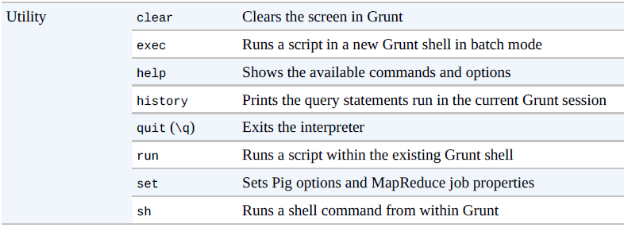
Utility Commands

Slide 43
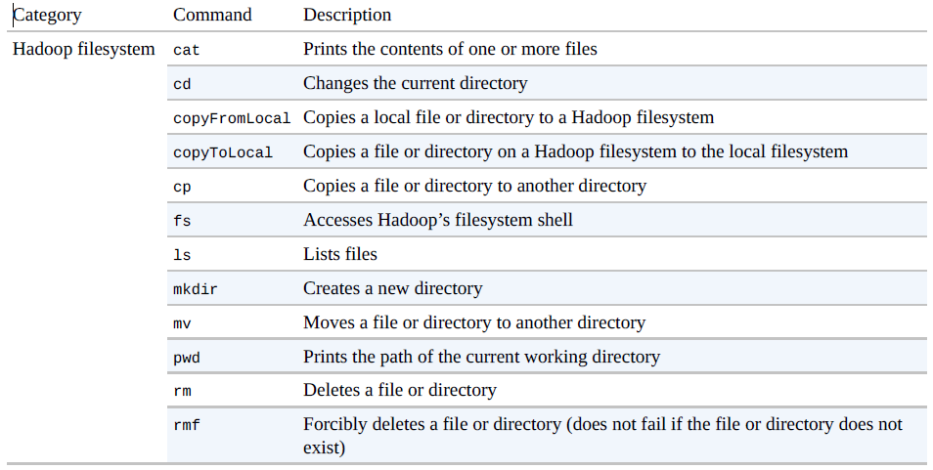
File System Commands

Slide 44
Pig Latin – Data types
Given below table describes the Pig Latin data types.
S.N. | Data Type | Description & Example
1 | int | Represents a signed 32-bit integer. Example : 8
2 | long | Represents a signed 64-bit integer. Example : 5L
3 | float | Represents a signed 32-bit floating point. Example : 5.5F
4 | double | Represents a 64-bit floating point. Example : 10.5
5 | chararray | Represents a character array (string) in Unicode UTF-8 format. Example : ‘tutorials point’
6 | Bytearray | Represents a Byte array (blob).
7 | Boolean | Represents a Boolean value. Example : true/ false.

Slide 45
8 | Datetime | Represents a date-time. Example : 1970-01-01T00:00:00.000+00:00
9 | Biginteger | Represents a Java BigInteger. Example : 60708090709
10 | Bigdecimal | Represents a Java BigDecimal Example : 185.98376256272893883
Complex Types
11 | Tuple | A tuple is an ordered set of fields. Example : (raja, 30)
12 | Bag | A bag is a collection of tuples. Example : {(raju,30),(Mohhammad,45)}
13 | Map | A Map is a set of key-value pairs. Example : [ ‘name’#’Raju’, ‘age’#30]

Slide 46
Null Values
Values for all the above data types can be NULL. Apache Pig treats null values in a similar way as SQL does.
A null can be an unknown value or a non-existent value. It is used as a placeholder for optional values. These nulls can occur naturally or can be the result of an operation.

Slide 47
Pig Latin – Arithmetic Operators
Arithmetic operators of Pig Latin. Suppose a = 10 and b = 20.
Operator | Description | Example
+ | Addition | a + b will give 30
− | Subtraction − | a − b will give −10
* | Multiplication | a * b will give 200
/ | Division − | b / a will give 2
% | Modulus − | b % a will give 0
? : | Bincond − Evaluates the Boolean operators. It has three variable x = (expression) ? value1 if true : value2 if false. | b = (a == 1)? 20: 30; if a = 1 the value of b is 20. if a!=1 the value of b is 30.
CASE WHEN THEN ELSE END | Case − The case operator is equivalent to nested bincond operator. | CASE f2 % 2 WHEN 0 THEN 'even' WHEN 1 THEN 'odd' END

Slide 48
Pig Latin – Comparison Operators
Operator | Description | Example
== | Equal − Checks if the values of two operands are equal or not; if yes, then the condition becomes true. | (a = b) is not true
!= | Not Equal − Checks if the values of two operands are equal or not. If the values are not equal, then condition becomes true. | (a != b) is true.
> | Greater than − Checks if the value of the left operand is greater than the value of the right operand. If yes, then the condition becomes true. | (a > b) is not true.
< | Less than − Checks if the value of the left operand is less than the value of the right operand. If yes, then the condition becomes true. | (a < b) is true.
>= | Greater than or equal to − Checks if the value of the left operand is greater than or equal to the value of the right operand. If yes, then the condition becomes true. | (a >= b) is not true.
<= | Less than or equal to − Checks if the value of the left operand is less than or equal to the value of the right operand. If yes, then the condition becomes true. | (a <= b) is true.
matches | Pattern matching − Checks whether the string in the left-hand side matches with the constant in the right-hand side. | f1 matches '.*tutorial.*'

Slide 49
Pig Latin – Type Construction Operators
Operator | Description | Example
() | Tuple constructor operator − This operator is used to construct a tuple. | (Raju, 30)
{} | Bag constructor operator − This operator is used to construct a bag. | {(Raju, 30), (Mohammad, 45)}
[] | Map constructor operator − This operator is used to construct a tuple. | [name#Raja, age#30]

Slide 50
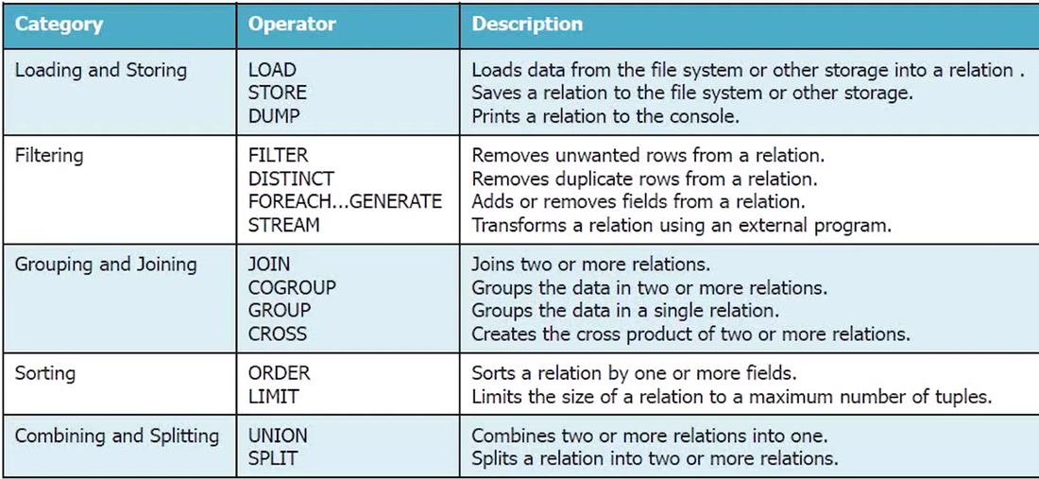
Working with Data

Slide 51
Pig Latin – Relational Operations
Operator | Description
Loading and Storing
LOAD | To Load the data from the file system (local/HDFS) into a relation.
STORE | To save a relation to the file system (local/HDFS).
Filtering
FILTER | To remove unwanted rows from a relation.
DISTINCT | To remove duplicate rows from a relation.
FOREACH, GENERATE | To generate data transformations based on columns of data.
STREAM | To transform a relation using an external program.
Grouping and Joining
JOIN | To join two or more relations.
COGROUP | To group the data in two or more relations.
GROUP | To group the data in a single relation.
CROSS | To create the cross product of two or more relations.

Slide 52
Sorting
ORDER | To arrange a relation in a sorted order based on one or more fields (ascending or descending).
LIMIT | To get a limited number of tuples from a relation.
Combining and Splitting
UNION | To combine two or more relations into a single relation.
SPLIT | To split a single relation into two or more relations.
Diagnostic Operators
DUMP | To print the contents of a relation on the console.
DESCRIBE | To describe the schema of a relation.
EXPLAIN | To view the logical, physical, or MapReduce execution plans to compute a relation.
ILLUSTRATE | To view the step-by-step execution of a series of statements.

Slide 53
Preparing HDFS
In MapReduce mode, Pig reads (loads) data from HDFS and stores the results back in HDFS.
Student ID | First Name | Last Name | Phone | City
001 | Rajiv | Reddy | 9848022337 | Hyderabad
002 | siddarth | Battacharya | 9848022338 | Kolkata
003 | Rajesh | Khanna | 9848022339 | Delhi
004 | Preethi | Agarwal | 9848022330 | Pune
005 | Trupthi | Mohanthy | 9848022336 | Bhuwaneshwar
006 | Archana | Mishra | 9848022335 | Chennai

Slide 54
Step 1: Verifying Hadoop
First of all, verify the installation using Hadoop version command, as shown below.
$ hadoop version
If your system contains Hadoop, and if you have set the PATH variable, then you will get the following output −
Hadoop 2.6.0 Subversion https://git-wip-us.apache.org/repos/asf/hadoop.git -r e3496499ecb8d220fba99dc5ed4c99c8f9e33bb1 Compiled by jenkins on 2014-11-13T21:10Z Compiled with protoc 2.5.0 From source with checksum 18e43357c8f927c0695f1e9522859d6a This command was run using /home/Hadoop/hadoop/share/hadoop/common/hadoop common-2.6.0.jar

Slide 55
Step 2: Starting HDFS
Browse through the sbin directory of Hadoop and start yarn and Hadoop dfs (distributed file system).
cd /$Hadoop_Home/sbin/
$ start-dfs.sh
localhost: starting namenode, logging to /home/Hadoop/hadoop/logs/hadoopHadoop-namenode- localhost.localdomain.out
localhost: starting datanode, logging to /home/Hadoop/hadoop/logs/hadoopHadoop-datanode-localhost.localdomain.out
Starting secondary namenodes [0.0.0.0]
starting secondarynamenode, logging to /home/Hadoop/hadoop/logs/hadoop-Hadoopsecondarynamenode-localhost.localdomain.out
$ start-yarn.sh
starting yarn daemons
starting resourcemanager, logging to /home/Hadoop/hadoop/logs/yarn-Hadoopresourcemanager-localhost.localdomain.out
localhost: starting nodemanager, logging to /home/Hadoop/hadoop/logs/yarnHadoop-nodemanager-localhost.localdomain.out

Slide 56
Step 4: Placing the data in HDFS
The input file of Pig contains each tuple/record in individual lines. And the entities of the record are separated by a delimiter (In our example we used “,”).
In the local file system, create an input file student_data.txt containing data as shown below.
001,Rajiv,Reddy,9848022337,Hyderabad 002,siddarth,Battacharya,9848022338,Kolkata 003,Rajesh,Khanna,9848022339,Delhi 004,Preethi,Agarwal,9848022330,Pune 005,Trupthi,Mohanthy,9848022336,Bhuwaneshwar 006,Archana,Mishra,9848022335,Chennai.
Now, move the file from the local file system to HDFS using put command as shown below. (You can use copyFromLocal command as well.)
$ cd $HADOOP_HOME/bin
$ hdfs dfs -put /home/Hadoop/Pig/Pig_Data/student_data.txt dfs://localhost:9000/pig_data/

Slide 57
Verifying the file You can use the cat command to verify whether the file has been moved into the HDFS, as shown below.
$ cd $HADOOP_HOME/bin
$ hdfs dfs -cat hdfs://localhost:9000/pig_data/student_data.txt
Output
You can see the content of the file as shown below.
15/10/01 12:16:55 WARN util.NativeCodeLoader: Unable to load native-hadoop library for your platform... using builtin-java classes where applicable
001,Rajiv,Reddy,9848022337,Hyderabad 002,siddarth,Battacharya,9848022338,Kolkata 003,Rajesh,Khanna,9848022339,Delhi 004,Preethi,Agarwal,9848022330,Pune 005,Trupthi,Mohanthy,9848022336,Bhuwaneshwar 006,Archana,Mishra,9848022335,Chennai

Slide 58
The Load Operator
You can load data into Apache Pig from the file system (HDFS/ Local) using LOAD operator of Pig Latin.
Syntax
The load statement consists of two parts divided by the “=” operator. On the left-hand side, we need to mention the name of the relation where we want to store the data, and on the right-hand side, we have to define how we store the data. Given below is the syntax of the Load operator.
Relation_name = LOAD 'Input file path' USING function as schema;

Slide 59
Where,
relation_name − We have to mention the relation in which we want to store the data.
Input file path − We have to mention the HDFS directory where the file is stored. (In MapReduce mode)
function − We have to choose a function from the set of load functions provided by Apache Pig (BinStorage, JsonLoader, PigStorage, TextLoader).
Schema − We have to define the schema of the data.
We can define the required schema as follows −
(column1 : data type, column2 : data type, column3 : data type);

Slide 60
Example
As an example, let us load the data in student_data.txt in Pig under the schema named Student using the LOAD command.
Start the Pig Grunt Shell
First of all, open the Linux terminal. Start the Pig Grunt shell in MapReduce mode as shown below.
$ Pig –x mapreduce
It will start the Pig Grunt shell as shown below.
15/10/01 12:33:37 INFO pig.ExecTypeProvider: Trying ExecType : LOCAL
15/10/01 12:33:37 INFO pig.ExecTypeProvider: Trying ExecType : MAPREDUCE
15/10/01 12:33:37 INFO pig.ExecTypeProvider: Picked MAPREDUCE as the ExecType
2015-10-01 12:33:38,080 [main] INFO org.apache.pig.Main - Apache Pig version 0.15.0 (r1682971) compiled Jun 01
2015, 11:44:35 2015-10-01 12:33:38,080 [main] INFO org.apache.pig.Main - Logging error messages to: /home/Hadoop/pig_1443683018078.log
2015-10-01 12:33:38,242 [main] INFO org.apache.pig.impl.util.Utils - Default bootup file /home/Hadoop/.pigbootup not found 2015-10-01 12:33:39,630 [main]
INFO org.apache.pig.backend.hadoop.executionengine.HExecutionEngine - Connecting to hadoop file system at: hdfs://localhost:9000
grunt>

Slide 61
Execute the Load Statement
Now load the data from the file student_data.txt into Pig by executing the following Pig Latin statement in the Grunt shell.
grunt> student = LOAD 'hdfs://localhost:9000/pig_data/student_data.txt' USING PigStorage(',') as ( id:int, firstname:chararray, lastname:chararray, phone:chararray, city:chararray );

Slide 62
Following is the description of the above statement.
Relation name | We have stored the data in the schema student.
Input file path | We are reading data from the file student_data.txt, which is in the /pig_data/ directory of HDFS.
Storage function | We have used the PigStorage() function. It loads and stores data as structured text files. It takes a delimiter using which each entity of a tuple is separated, as a parameter. By default, it takes ‘\t’ as a parameter.
schema | We have stored the data using the following schema.
column | id | firstname | lastname | phone | city
datatype | int | char array | char array | char array | char array

Slide 63
Apache Pig - Storing Data
Syntax
Given below is the syntax of the Store statement.
STORE Relation_name INTO ' required_directory_path ' [USING function];
Example
Assume we have a file student_data.txt in HDFS with the following content.
001,Rajiv,Reddy,9848022337,Hyderabad 002,siddarth,Battacharya,9848022338,Kolkata 003,Rajesh,Khanna,9848022339,Delhi 004,Preethi,Agarwal,9848022330,Pune 005,Trupthi,Mohanthy,9848022336,Bhuwaneshwar 006,Archana,Mishra,9848022335,Chennai.

Slide 64
And we have read it into a relation student using the LOAD operator as shown below.
grunt> student = LOAD 'hdfs://localhost:9000/pig_data/student_data.txt' USING PigStorage(',') as ( id:int, firstname:chararray, lastname:chararray, phone:chararray, city:chararray );
Now, let us store the relation in the HDFS directory “/pig_Output/” .
grunt> STORE student INTO ' hdfs://localhost:9000/pig_Output/ ' USING PigStorage (',');

Slide 65
Output
After executing the store statement, you will get the following output. A directory is created with the specified name and the data will be stored in it.
2015-10-05 13:05:05,429 [main] INFO org.apache.pig.backend.hadoop.executionengine.mapReduceLayer. MapReduceLau ncher - 100% complete
2015-10-05 13:05:05,429 [main] INFO org.apache.pig.tools.pigstats.mapreduce.SimplePigStats - Script Statistics:
HadoopVersion PigVersion UserId StartedAt FinishedAt Features
2.6.0 0.15.0 Hadoop 2015-10-0 13:03:03 2015-10-05 13:05:05 UNKNOWN
Success!
Job Stats (time in seconds):
JobId Maps Reduces MaxMapTime MinMapTime AvgMapTime MedianMapTime
job_14459_06 1 0 n/a n/a n/a n/a
MaxReduceTime MinReduceTime AvgReduceTime MedianReducetime Alias Feature
0 0 0 0 student MAP_ONLY
OutPut folder
hdfs://localhost:9000/pig_Output/
Input(s): Successfully read 0 records from: "hdfs://localhost:9000/pig_data/student_data.txt" Output(s): Successfully stored 0 records in: "hdfs://localhost:9000/pig_Output"
Counters: Total records written : 0
Total bytes written : 0
Spillable Memory Manager spill count : 0
Total bags proactively spilled: 0
Total records proactively spilled: 0
Job DAG: job_1443519499159_0006
2015-10-05 13:06:06,192 [main] INFO org.apache.pig.backend.hadoop.executionengine .mapReduceLayer.MapReduceLau ncher –
Success!

Slide 66
Verification
You can verify the stored data as shown below.
Step 1
First of all, list out the files in the directory named pig_output using the ls command as shown below.
hdfs dfs -ls 'hdfs://localhost:9000/pig_Output/' Found 2 items
rw-r--r- 1 Hadoop supergroup 0 2015-10-05 13:03 hdfs://localhost:9000/pig_Output/_SUCCESS
rw-r--r- 1 Hadoop supergroup 224 2015-10-05 13:03 hdfs://localhost:9000/pig_Output/part-m-00000

Slide 67
Step 2
Using cat command, list the contents of the file named part-m-00000 as shown below.
$ hdfs dfs -cat 'hdfs://localhost:9000/pig_Output/part-m-00000'
1,Rajiv,Reddy,9848022337,Hyderabad 2,siddarth,Battacharya,9848022338,Kolkata 3,Rajesh,Khanna,9848022339,Delhi 4,Preethi,Agarwal,9848022330,Pune 5,Trupthi,Mohanthy,9848022336,Bhuwaneshwar 6,Archana,Mishra,9848022335,Chennai

Slide 68
Diagnostic Operators
The load statement will simply load the data into the specified relation in Apache Pig. To verify the execution of the Load statement, you have to use the Diagnostic Operators.
Pig Latin provides four different types of diagnostic operators −
Dump operator
Describe operator
Explanation operator
Illustration operator

Slide 69
Dump Operator
The Dump operator is used to run the Pig Latin statements and display the results on the screen. It is generally used for debugging Purpose.
Syntax
Given below is the syntax of the Dump operator.
grunt> Dump Relation_Name
Example
Assume we have a file student_data.txt in HDFS with the following content.
001,Rajiv,Reddy,9848022337,Hyderabad 002,siddarth,Battacharya,9848022338,Kolkata 003,Rajesh,Khanna,9848022339,Delhi 004,Preethi,Agarwal,9848022330,Pune 005,Trupthi,Mohanthy,9848022336,Bhuwaneshwar 006,Archana,Mishra,9848022335,Chennai.

Slide 70
And we have read it into a relation student using the LOAD operator as shown below.
grunt> student = LOAD 'hdfs://localhost:9000/pig_data/student_data.txt' USING PigStorage(',') as ( id:int, firstname:chararray, lastname:chararray, phone:chararray, city:chararray );
Dump operator prints the contents .
grunt> Dump student

Slide 71
Describe Operator
The describe operator is used to view the schema of a relation.
Syntax
The syntax of the describe operator is as follows −
grunt> Describe Relation_name
Example
Assume we have a file student_data.txt in HDFS with the following content.
001,Rajiv,Reddy,9848022337,Hyderabad 002,siddarth,Battacharya,9848022338,Kolkata 003,Rajesh,Khanna,9848022339,Delhi 004,Preethi,Agarwal,9848022330,Pune 005,Trupthi,Mohanthy,9848022336,Bhuwaneshwar 006,Archana,Mishra,9848022335,Chennai.
grunt> describe student;
Output
Once you execute the above Pig Latin statement, it will produce the following output.
grunt> student: { id: int,firstname: chararray,lastname: chararray,phone: chararray,city: chararray }

Slide 72
Explain Operator
The explain operator is used to display the logical, physical, and MapReduce execution plans of a relation.
Syntax
Given below is the syntax of the explain operator.
grunt> explain Relation_name; Example
Assume we have a file student_data.txt in HDFS with the following content.
001,Rajiv,Reddy,9848022337,Hyderabad 002,siddarth,Battacharya,9848022338,Kolkata 003,Rajesh,Khanna,9848022339,Delhi 004,Preethi,Agarwal,9848022330,Pune 005,Trupthi,Mohanthy,9848022336,Bhuwaneshwar 006,Archana,Mishra,9848022335,Chennai.

Slide 73
The GROUP operator is used to group the data in one or more relations. It collects the data having the same key.
Syntax
Given below is the syntax of the group operator.
grunt> Group_data = GROUP Relation_name BY age;
Example
Assume that we have a file named student_details.txt in the HDFS directory /pig_data/ as shown below.
student_details.txt
001,Rajiv,Reddy,21,9848022337,Hyderabad 002,siddarth,Battacharya,22,9848022338,Kolkata 003,Rajesh,Khanna,22,9848022339,Delhi 004,Preethi,Agarwal,21,9848022330,Pune 005,Trupthi,Mohanthy,23,9848022336,Bhuwaneshwar 006,Archana,Mishra,23,9848022335,Chennai 007,Komal,Nayak,24,9848022334,trivendram 008,Bharathi,Nambiayar,24,9848022333,Chennai
grunt> group_data = GROUP student_details by age;

Slide 74
Output
Then you will get output displaying the contents of the relation named group_data as shown below. Here you can observe that the resulting schema has two columns −
One is age, by which we have grouped the relation.
The other is a bag, which contains the group of tuples, student records with the respective age.
(21,{(4,Preethi,Agarwal,21,9848022330,Pune),(1,Rajiv,Reddy,21,9848022337,Hydera bad)}) (22,{(3,Rajesh,Khanna,22,9848022339,Delhi),(2,siddarth,Battacharya,22,984802233 8,Kolkata)}) (23,{(6,Archana,Mishra,23,9848022335,Chennai),(5,Trupthi,Mohanthy,23,9848022336 ,Bhuwaneshwar)}) (24,{(8,Bharathi,Nambiayar,24,9848022333,Chennai),(7,Komal,Nayak,24,9848022334, trivendram)})

Slide 75
You can see the schema of the table after grouping the data using the describe command as shown below.
grunt> Describe group_data;
group_data: {group: int,student_details: {(id: int,firstname: chararray, lastname: chararray,age: int,phone: chararray,city: chararray)}}
In the same way, you can get the sample illustration of the schema using the illustrate command as shown below.
$ Illustrate group_data;
$ Illustrate group_data;
It will produce the following output −
--------------------------------------------------------------------------------------------
|group_data| group:int | student_details:bag{:tuple(id:int,firstname:chararray,lastname:chararray,age:int,phone:chararray,city:chararray)}|
--------------------------------------------------------------------------------------------
| | 21 | { 4, Preethi, Agarwal, 21, 9848022330, Pune), (1, Rajiv, Reddy, 21, 9848022337, Hyderabad)}|
| | 2 | {(2,siddarth,Battacharya,22,9848022338,Kolkata),(003,Rajesh,Khanna,22,9848022339,Delhi)}|-
------------------------------------------------------------------------------------------

Slide 76
Grouping by Multiple Columns
Let us group the relation by age and city as shown below.
grunt> group_multiple = GROUP student_details by (age, city);
grunt> Dump group_multiple;
((21,Pune),{(4,Preethi,Agarwal,21,9848022330,Pune)}) ((21,Hyderabad),{(1,Rajiv,Reddy,21,9848022337,Hyderabad)}) ((22,Delhi),{(3,Rajesh,Khanna,22,9848022339,Delhi)}) ((22,Kolkata),{(2,siddarth,Battacharya,22,9848022338,Kolkata)}) ((23,Chennai),{(6,Archana,Mishra,23,9848022335,Chennai)}) ((23,Bhuwaneshwar),{(5,Trupthi,Mohanthy,23,9848022336,Bhuwaneshwar)}) ((24,Chennai),{(8,Bharathi,Nambiayar,24,9848022333,Chennai)}) (24,trivendram),{(7,Komal,Nayak,24,9848022334,trivendram)})

Slide 77
Group All
You can group a relation by all the columns as shown below.
grunt> group_all = GROUP student_details All;
Now, verify the content of the relation group_all as shown below.
grunt> Dump group_all;
(all,{(8,Bharathi,Nambiayar,24,9848022333,Chennai),(7,Komal,Nayak,24,9848022334 ,trivendram), (6,Archana,Mishra,23,9848022335,Chennai),(5,Trupthi,Mohanthy,23,9848022336,Bhuw aneshwar), (4,Preethi,Agarwal,21,9848022330,Pune),(3,Rajesh,Khanna,22,9848022339,Delhi), (2,siddarth,Battacharya,22,9848022338,Kolkata),(1,Rajiv,Reddy,21,9848022337,Hyd erabad)})

Slide 78
Cogroup Operator
The COGROUP operator works more or less in the same way as the GROUP operator. The only difference between the two operators is that the group operator is normally used with one relation, while the cogroup operator is used in statements involving two or more relations.

Slide 79
Grouping Two Relations using Cogroup
Assume that we have two files namely student_details.txt and employee_details.txt in the HDFS directory /pig_data/ as shown below.
student_details.txt
001,Rajiv,Reddy,21,9848022337,Hyderabad 002,siddarth,Battacharya,22,9848022338,Kolkata 003,Rajesh,Khanna,22,9848022339,Delhi 004,Preethi,Agarwal,21,9848022330,Pune 005,Trupthi,Mohanthy,23,9848022336,Bhuwaneshwar 006,Archana,Mishra,23,9848022335,Chennai 007,Komal,Nayak,24,9848022334,trivendram 008,Bharathi,Nambiayar,24,9848022333,Chennai
employee_details.txt
001,Robin,22,newyork
002,BOB,23,Kolkata
003,Maya,23,Tokyo
004,Sara,25,London
005,David,23,Bhuwaneshwar
006,Maggy,22,Chennai

Slide 80
And we have loaded these files into Pig with the relation names student_details and employee_details respectively, as shown below.
grunt> student_details = LOAD 'hdfs://localhost:9000/pig_data/student_details.txt' USING PigStorage(',') as (id:int, firstname:chararray, lastname:chararray, age:int, phone:chararray, city:chararray);
grunt> employee_details = LOAD 'hdfs://localhost:9000/pig_data/employee_details.txt' USING PigStorage(',') as (id:int, name:chararray, age:int, city:chararray);
grunt> cogroup_data = COGROUP student_details by age, employee_details by age;

Slide 81
Verification
Verify the relation cogroup_data using the DUMP operator as shown below.
grunt> Dump cogroup_data;Output
It will produce the following output, displaying the contents of the relation named cogroup_data as shown below.
(21,{(4,Preethi,Agarwal,21,9848022330,Pune), (1,Rajiv,Reddy,21,9848022337,Hyderabad)}, { }) (22,{ (3,Rajesh,Khanna,22,9848022339,Delhi), (2,siddarth,Battacharya,22,9848022338,Kolkata) }, { (6,Maggy,22,Chennai),(1,Robin,22,newyork) }) (23,{(6,Archana,Mishra,23,9848022335,Chennai),(5,Trupthi,Mohanthy,23,9848022336 ,Bhuwaneshwar)}, {(5,David,23,Bhuwaneshwar),(3,Maya,23,Tokyo),(2,BOB,23,Kolkata)})

Slide 82
GROUP. . .ALL
Use the GROUP…ALL operator to group data
Use GROUP when only one relation is involved
Use COGROUP with multiple relations are involved
Basic syntax:
alias2 = GROUP alias1 ALL;
Example:
DUMP alias1;
(John,18,4.0F) (Mary,19,3.8F) (Bill,20,3.9F) (Joe,18,3.8F)
alias2 = GROUP alias1 BY col2;
DUMP alias2;
(18,{(John,18,4.0F),(Joe,18,3.8F)})
(19,{(Mary,19,3.8F)})
(20,{(Bill,20,3.9F)})

Slide 83
ORDER. . .BY
Use the ORDER…BY operator to sort a relation based on one or more fields
Basic syntax:
alias = ORDER alias BY field_alias [ASC|DESC];
Example:
DUMP alias1;
(1,2,3) (4,2,1) (8,3,4) (4,3,3) (7,2,5) (8,4,3)
alias2 = ORDER alias1 BY col3 DESC;
DUMP alias2;
(7,2,5) (8,3,4) (1,2,3) (4,3,3) (8,4,3) (4,2,1)

Slide 84
DISTINCT. . .
Use the DISTINCT operator to remove duplicate tuples in a relation.
Basic syntax:
alias2 = DISTINCT alias1;
Example:
DUMP alias1;
(8,3,4) (1,2,3) (4,3,3) (4,3,3) (1,2,3)
alias2= DISTINCT alias1;
DUMP alias2;
(8,3,4) (1,2,3) (4,3,3)

Slide 85
Join Operator
The JOIN operator is used to combine records from two or more relations. While performing a join operation, we declare one (or a group of) tuple(s) from each relation, as keys. When these keys match, the two particular tuples are matched, else the records are dropped. Joins can be of the following types −
Self-join
Inner-join
Outer-join − left join, right join, and full join

Slide 86
customers.txt
1,Ramesh,32,Ahmedabad,2000.00 2,Khilan,25,Delhi,1500.00 3,kaushik,23,Kota,2000.00 4,Chaitali,25,Mumbai,6500.00 5,Hardik,27,Bhopal,8500.00 6,Komal,22,MP,4500.00 7,Muffy,24,Indore,10000.00
orders.txt
102,2009-10-08 00:00:00,3,3000 100,2009-10-08 00:00:00,3,1500 101,2009-11-20 00:00:00,2,1560 103,2008-05-20 00:00:00,4,2060

Slide 87
grunt> customers = LOAD 'hdfs://localhost:9000/pig_data/customers.txt' USING PigStorage(',') as (id:int, name:chararray, age:int, address:chararray, salary:int);
grunt> orders = LOAD 'hdfs://localhost:9000/pig_data/orders.txt' USING PigStorage(',') as (oid:int, date:chararray, customer_id:int, amount:int);

Slide 88
Syntax
Given below is the syntax of performing self-join operation using the JOIN operator.
grunt> Relation3_name = JOIN Relation1_name BY key, Relation2_name BY key ;
Example
Let us perform self-join operation on the relation customers, by joining the two relations customers1 and customers2 as shown below.
grunt> customers3 = JOIN customers1 BY id, customers2 BY id;
Output
It will produce the following output, displaying the contents of the relation customers.
(1,Ramesh,32,Ahmedabad,2000,1,Ramesh,32,Ahmedabad,2000) (2,Khilan,25,Delhi,1500,2,Khilan,25,Delhi,1500) (3,kaushik,23,Kota,2000,3,kaushik,23,Kota,2000) (4,Chaitali,25,Mumbai,6500,4,Chaitali,25,Mumbai,6500) (5,Hardik,27,Bhopal,8500,5,Hardik,27,Bhopal,8500) (6,Komal,22,MP,4500,6,Komal,22,MP,4500) (7,Muffy,24,Indore,10000,7,Muffy,24,Indore,10000)

Slide 89
Inner Join is used quite frequently; it is also referred to as equijoin. An inner join returns rows when there is a match in both tables.
grunt> result = JOIN relation1 BY columnname, relation2 BY columnname;
Example
Let us perform inner join operation on the two relations customers and orders as shown below.
grunt> coustomer_orders = JOIN customers BY id, orders BY customer_id;
grunt> Dump coustomer_orders;Output
You will get the following output that will the contents of the relation named coustomer_orders.
(2,Khilan,25,Delhi,1500,101,2009-11-20 00:00:00,2,1560) (3,kaushik,23,Kota,2000,100,2009-10-08 00:00:00,3,1500) (3,kaushik,23,Kota,2000,102,2009-10-08 00:00:00,3,3000) (4,Chaitali,25,Mumbai,6500,103,2008-05-20 00:00:00,4,2060)

Slide 90
The FILTER operator is used to select the required tuples from a relation based on a condition.
Syntax
Given below is the syntax of the FILTER operator.
grunt> Relation2_name = FILTER Relation1_name BY (condition);
Example
Assume that we have a file named student_details.txt in the HDFS directory /pig_data/ as shown below.
student_details.txt
001,Rajiv,Reddy,21,9848022337,Hyderabad 002,siddarth,Battacharya,22,9848022338,Kolkata 003,Rajesh,Khanna,22,9848022339,Delhi 004,Preethi,Agarwal,21,9848022330,Pune 005,Trupthi,Mohanthy,23,9848022336,Bhuwaneshwar 006,Archana,Mishra,23,9848022335,Chennai 007,Komal,Nayak,24,9848022334,trivendram 008,Bharathi,Nambiayar,24,9848022333,Chennai
grunt> student_details = LOAD 'hdfs://localhost:9000/pig_data/student_details.txt' USING PigStorage(',') as (id:int, firstname:chararray, lastname:chararray, age:int, phone:chararray, city:chararray);

Slide 91
filter_data = FILTER student_details BY city == 'Chennai';
grunt> Dump filter_data;
(6,Archana,Mishra,23,9848022335,Chennai) (grunt> Relation_name2 = DISTINCT Relatin_name1;8,Bharathi,Nambiayar,24,9848022333,Chennai)
The DISTINCT operator is used to remove redundant (duplicate) tuples from a relation.
grunt> Relation_name2 = DISTINCT Relatin_name1;

Slide 92
The FOREACH operator is used to generate specified data transformations based on the column data.
Syntax
Given below is the syntax of FOREACH operator.
grunt> Relation_name2 = FOREACH Relatin_name1 GENERATE (required data); Example
Assume that we have a file named student_details.txt in the HDFS directory /pig_data/ as shown below.
student_details.txt
001,Rajiv,Reddy,21,9848022337,Hyderabad 002,siddarth,Battacharya,22,9848022338,Kolkata 003,Rajesh,Khanna,22,9848022339,Delhi 004,Preethi,Agarwal,21,9848022330,Pune 005,Trupthi,Mohanthy,23,9848022336,Bhuwaneshwar 006,Archana,Mishra,23,9848022335,Chennai 007,Komal,Nayak,24,9848022334,trivendram 008,Bharathi,Nambiayar,24,9848022333,Chennai

Slide 93
FILTER. . .BY
Use the FILTER operator to restrict tuples or rows of data
Basic syntax:
alias2 = FILTER alias1 BY expression;
Example:
DUMP alias1;
(1,2,3) (4,2,1) (8,3,4) (4,3,3) (7,2,5) (8,4,3)
alias2 = FILTER alias1 BY (col1 == 8) OR (NOT (col2+col3 > col1));
DUMP alias2;
(4,2,1) (8,3,4) (7,2,5) (8,4,3)

Slide 94
grunt> student_details = LOAD 'hdfs://localhost:9000/pig_data/student_details.txt' USING PigStorage(',') as (id:int, firstname:chararray, lastname:chararray,age:int, phone:chararray, city:chararray);
grunt> foreach_data = FOREACH student_details GENERATE id,age,city;
grunt> Dump foreach_data;
(1,21,Hyderabad)
(2,22,Kolkata)
(3,22,Delhi)
(4,21,Pune)
(5,23,Bhuwaneshwar)
(6,23,Chennai)
(7,24,trivendram)
(8,24,Chennai)

Slide 95
The ORDER BY operator is used to display the contents of a relation in a sorted order based on one or more fields.
Syntax
Given below is the syntax of the ORDER BY operator.
grunt> Relation_name2 = ORDER Relatin_name1 BY (ASC|DESC);
Example
Assume that we have a file named student_details.txt in the HDFS directory /pig_data/ as shown below.
student_details.txt
001,Rajiv,Reddy,21,9848022337,Hyderabad 002,siddarth,Battacharya,22,9848022338,Kolkata 003,Rajesh,Khanna,22,9848022339,Delhi 004,Preethi,Agarwal,21,9848022330,Pune 005,Trupthi,Mohanthy,23,9848022336,Bhuwaneshwar 006,Archana,Mishra,23,9848022335,Chennai 007,Komal,Nayak,24,9848022334,trivendram 008,Bharathi,Nambiayar,24,9848022333,Chennai

Slide 96
grunt> student_details = LOAD 'hdfs://localhost:9000/pig_data/student_details.txt' USING PigStorage(',') as (id:int, firstname:chararray, lastname:chararray,age:int, phone:chararray, city:chararray);
grunt> order_by_data = ORDER student_details BY age DESC;
grunt> Dump order_by_data;
(8,Bharathi,Nambiayar,24,9848022333,Chennai) (7,Komal,Nayak,24,9848022334,trivendram) (6,Archana,Mishra,23,9848022335,Chennai) (5,Trupthi,Mohanthy,23,9848022336,Bhuwaneshwar) (3,Rajesh,Khanna,22,9848022339,Delhi) (2,siddarth,Battacharya,22,9848022338,Kolkata) (4,Preethi,Agarwal,21,9848022330,Pune) (1,Rajiv,Reddy,21,9848022337,Hyderabad)

Slide 97
Create a sample file
John,18,4.0
Mary,19,3.8
Bill,20,3.9
Joe,18,3.8
Save it as “student.txt”
Move it to HDFS by using below command.
hadoop fs – put <local path - filename> hdfspath

Slide 98
LOAD/DUMP/STORE
A = load 'student' using PigStorage(‘,’) AS (name:chararray,age:int,gpa:float);
DESCRIBE A;
A: {name: chararray,age: int,gpa: float}
DUMP A;
(John,18,4.0)
(Mary,19,3.8)
(Bill,20,3.9)
(Joe,18,3.8)
store A into ‘/hdfspath’;

Slide 99
Group
Groups the data in one relations.
B = GROUP A BY age;
DUMP B;
(18,{(John,18,4.0),(Joe,18,3.8)})
(19,{(Mary,19,3.8)})
(20,{(Bill,20,3.9)})

Slide 100
Foreach…Generate
C = FOREACH B GENERATE group, COUNT(A);
DUMP C;
(18,2)
(19,1)
(20,1)
C = FOREACH B GENERATE $0, $1.name;
DUMP C;
(18,{(John),(Joe)})
(19,{(Mary)})
(20,{(Bill)})

Slide 101
Create Sample File
FileA.txt
1 2 3
4 2 1
8 3 4
4 3 3
7 2 5
8 4 3
Move it to HDFS by using below command.
hadoop fs – put <localpath> <hdfspath>

Slide 102
Create another Sample File
FileB.txt
2 4
8 9
1 3
2 7
2 9
4 6
4 9
Move it to HDFS by using below command.
hadoop fs – put localpath hdfspath

Slide 103
Filter
Definition: Selects tuples from a relation based on some condition.
FILTER is commonly used to select the data that you want; or, conversely, to filter out (remove) the data you don’t want.
Examples
A = LOAD 'data' using PigStorage(‘,’) AS (a1:int,a2:int,a3:int);
DUMP A;
(1,2,3)
(4,2,1)
(8,3,4)
(4,3,3)
(7,2,5)
(8,4,3)
X = FILTER A BY a3 == 3;
DUMP X;
(1,2,3)
(4,3,3)
(8,4,3)

Slide 104
Co-Group
Definition: The GROUP and COGROUP operators are identical. For readability GROUP is used in statements involving one relation and COGROUP is used in statements involving two or more relations.
X = COGROUP A BY $0, B BY $0;
(1, {(1, 2, 3)}, {(1, 3)})
(2, {}, {(2, 4), (2, 7), (2, 9)})
(4, {(4, 2, 1), (4, 3, 3)}, {(4, 6),(4, 9)})
(7, {(7, 2, 5)}, {})
(8, {(8, 3, 4), (8, 4, 3)}, {(8, 9)})
To see groups for which inputs have at least one tuple:
X = COGROUP A BY $0 INNER, B BY $0 INNER;
(1, {(1, 2, 3)}, {(1, 3)})
(4, {(4, 2, 1), (4, 3, 3)}, {(4, 6), (4, 9)})
(8, {(8, 3, 4), (8, 4, 3)}, {(8, 9)})
FileA
1 2 3
4 2 1
8 3 4
4 3 3
7 2 5
8 4 3
FileB.txt
2 4
8 9
1 3
2 7
2 9
4 6
4 9

Slide 105
JOIN
Definition: Performs join of two or more relations based on common field values
Syntax:
X= JOIN A BY $0, B BY $0;
which is equivalent to:
X = COGROUP A BY $0 INNER, B BY $0 INNER;
Y = FOREACH X GENERATE FLATTEN(A), FLATTEN(B);
The result is:
(1, 2, 3, 1, 3)
(4, 2, 1, 4, 6)
(4, 3, 3, 4, 6)
(4, 2, 1, 4, 9)
(4, 3, 3, 4, 9)
(8, 3, 4, 8, 9)
(8, 4, 3, 8, 9)
(1, {(1, 2, 3)}, {(1, 3)})
(4, {(4, 2, 1), (4, 3, 3)}, {(4, 6), (4, 9)})
(8, {(8, 3, 4), (8, 4, 3)}, {(8, 9)})

Slide 106
INNER JOIN Example
Join Alias1 by Col1 to Alias2 by Col1
Alias3 = JOIN Alias1 BY Col1, Alias2 BY Col1;
Dump Alias3;
(1,2,3,1,3)
(4,2,1,4,6)
(4,3,3,4,6)
(4,2,1,4,9)
(4,3,3,4,9)
(8,3,4,8,9)
(8,4,3,8,9)
DUMP Alias1;
(1,2,3)
(4,2,1)
(8,3,4)
(4,3,3)
(7,2,5)
(8,4,3)
DUMP Alias2;
(2,4)
(8,9)
(1,3)
(2,7)
(2,9)
(4,6)
(4,9)

Slide 107
CROSS
Computes the cross product of two or more relations.
Example: X = CROSS A, B;
(1, 2, 3, 2, 4)
(1, 2, 3, 8, 9)
(1, 2, 3, 1, 3)
(1, 2, 3, 2, 7)
(1, 2, 3, 2, 9)
(1, 2, 3, 4, 6)
(1, 2, 3, 4, 9)
(4, 2, 1, 2, 4)
(4, 2, 1, 8, 9)

Slide 108
Example
i/p: webcount
en google.com 70 2012
en yahoo.com 60 2013
us google.com 80 2012
en google.com 40 2014
us google.com 80 2012
records = LOAD ‘webcount’ using PigStorage (‘\t’) as (country:chararray, name:chararray, pagecount:int, year:int);
filtered_records = filter records by country == ‘en’;
grouped_records = group filtered_records by name;
results = foreach grouped_records generate group, SUM (filtered_records.pagecount);
sorted_result = order results by $1 desc;
store sorted_result into ‘/some_external_HDFS_location//data’; -- Hive external table path

Slide 109
Find Maximum Score
i/p: CricketScore.txt
a = load '/user/cloud/SampleDataFile/CricketScore.txt' using PigStorage('\t');
b = foreach a generate $0, $1;
c = group b by $0;
d = foreach c generate group, max(b.$1);
dump d;

Slide 110
Sorting Data
Relations are unordered in Pig.
Consider a relation A:
grunt> DUMP A;
(2,3)
(1,2)
(2,4)
There is no guarantee which order the rows will be processed in. In particular, when retrieving the contents of A using DUMP or STORE, the rows may be written in any order. If you want to impose an order on the output, you can use the ORDER operator to sort a relation by one or more fields.
The following example sorts A by the first field in ascending order and by the second field in descending order:
grunt> B = ORDER A BY $0, $1 DESC;
grunt> DUMP B;
(1,2)
(2,4)
(2,3)
Any further processing on a sorted relation is not guaranteed to retain its order.

Slide 111
Eval Functions
Apache Pig provides various built-in functions amely eval, load, store, math, string, bag and tuple functions
Eval Functions
S.N. | Function & Description
1 | AVG()To compute the average of the numerical values within a bag.
2 | BagToString()To concatenate the elements of a bag into a string. While concatenating, we can place a delimiter between these values (optional).
3 | CONCAT()To concatenate two or more expressions of same type.
4 | COUNT()To get the number of elements in a bag, while counting the number of tuples in a bag.
5 | COUNT_STAR()It is similar to the COUNT() function. It is used to get the number of elements in a bag.
6 | DIFF()To compare two bags (fields) in a tuple.
7 | IsEmpty()To check if a bag or map is empty.

Slide 112
8 | MAX()To calculate the highest value for a column (numeric values or chararrays) in a single-column bag.
9 | MIN()To get the minimum (lowest) value (numeric or chararray) for a certain column in a single-column bag.
10 | PluckTuple()Using the Pig Latin PluckTuple() function, we can define a string Prefix and filter the columns in a relation that begin with the given prefix.
11 | SIZE()To compute the number of elements based on any Pig data type.
12 | SUBTRACT()To subtract two bags. It takes two bags as inputs and returns a bag which contains the tuples of the first bag that are not in the second bag.
13 | SUM()To get the total of the numeric values of a column in a single-column bag.
14 | TOKENIZE()To split a string (which contains a group of words) in a single tuple and return a bag which contains the output of the split operation.

Slide 113
The Load and Store functions in Apache Pig are used to determine how the data goes ad comes out of Pig. These functions are used with the load and store operators. Given below is the list of load and store functions available in Pig.
S.N. | Function & Description
1 | PigStorage()To load and store structured files.
2 | TextLoader()To load unstructured data into Pig.
3 | BinStorage()To load and store data into Pig using machine readable format.
4 | Handling Compression In Pig Latin, we can load and store compressed data.

Slide 114
Bag & Tuple Functions
Given below is the list of Bag and Tuple functions.
S.N. | Function & Description
1 | TOBAG()To convert two or more expressions into a bag.
2 | TOP()To get the top N tuples of a relation.
3 | TOTUPLE()To convert one or more expressions into a tuple.
4 | TOMAP()To convert the key-value pairs into a Map.

Slide 115
String Functions
We have the following String functions in Apache Pig.
S.N. | Functions & Description
1 | ENDSWITH(string, testAgainst)To verify whether a given string ends with a particular substring.
2 | STARTSWITH(string, substring)Accepts two string parameters and verifies whether the first string starts with the second.
3 | SUBSTRING(string, startIndex, stopIndex)Returns a substring from a given string.
4 | EqualsIgnoreCase(string1, string2)To compare two stings ignoring the case.
5 | INDEXOF(string, ‘character’, startIndex)Returns the first occurrence of a character in a string, searching forward from a start index.
6 | LAST_INDEX_OF(expression)Returns the index of the last occurrence of a character in a string, searching backward from a start index.
7 | LCFIRST(expression)Converts the first character in a string to lower case.

Slide 116
8 | UCFIRST(expression)Returns a string with the first character converted to upper case.
9 | UPPER(expression)UPPER(expression) Returns a string converted to upper case.
10 | LOWER(expression)Converts all characters in a string to lower case.
11 | REPLACE(string, ‘oldChar’, ‘newChar’);To replace existing characters in a string with new characters.
12 | STRSPLIT(string, regex, limit)To split a string around matches of a given regular expression.
13 | STRSPLITTOBAG(string, regex, limit)Similar to the STRSPLIT() function, it splits the string by given delimiter and returns the result in a bag.
14 | TRIM(expression)Returns a copy of a string with leading and trailing whitespaces removed.
15 | LTRIM(expression)Returns a copy of a string with leading whitespaces removed.
16 | RTRIM(expression)Returns a copy of a string with trailing whitespaces removed.

Slide 117
Date-time Functions
Apache Pig provides the following Date and Time functions −
S.N. | Functions & Description
1 | ToDate(milliseconds) This function returns a date-time object according to the given parameters. The other alternative for this function are ToDate(iosstring), ToDate(userstring, format), ToDate(userstring, format, timezone)
2 | CurrentTime() returns the date-time object of the current time.
3 | GetDay(datetime)Returns the day of a month from the date-time object.
4 | GetHour(datetime)Returns the hour of a day from the date-time object.
5 | GetMilliSecond(datetime)Returns the millisecond of a second from the date-time object.
6 | GetMinute(datetime)Returns the minute of an hour from the date-time object.
7 | GetMonth(datetime)Returns the month of a year from the date-time object.
8 | GetSecond(datetime)Returns the second of a minute from the date-time object.
9 | GetWeek(datetime)Returns the week of a year from the date-time object.
10 | GetWeekYear(datetime)Returns the week year from the date-time object.

Slide 118
11 | GetYear(datetime)Returns the year from the date-time object.
12 | AddDuration(datetime, duration)Returns the result of a date-time object along with the duration object.
13 | SubtractDuration(datetime, duration)Subtracts the Duration object from the Date-Time object and returns the result.
14 | DaysBetween(datetime1, datetime2)Returns the number of days between the two date-time objects.
15 | HoursBetween(datetime1, datetime2)Returns the number of hours between two date-time objects.
16 | MilliSecondsBetween(datetime1, datetime2)Returns the number of milliseconds between two date-time objects.
17 | MinutesBetween(datetime1, datetime2)Returns the number of minutes between two date-time objects.
18 | MonthsBetween(datetime1, datetime2)Returns the number of months between two date-time objects.
19 | SecondsBetween(datetime1, datetime2)Returns the number of seconds between two date-time objects.
20 | WeeksBetween(datetime1, datetime2)Returns the number of weeks between two date-time objects.
21 | YearsBetween(datetime1, datetime2)Returns the number of years between two date-time objects.

Slide 119
Math Functions
S.N. | Functions & Description
1 | ABS(expression)To get the absolute value of an expression.
2 | ACOS(expression)To get the arc cosine of an expression.
3 | ASIN(expression)To get the arc sine of an expression.
4 | ATAN(expression)This function is used to get the arc tangent of an expression.
5 | CBRT(expression)This function is used to get the cube root of an expression.
6 | CEIL(expression)This function is used to get the value of an expression rounded up to the nearest integer.
7 | COS(expression)This function is used to get the trigonometric cosine of an expression.
8 | COSH(expression)This function is used to get the hyperbolic cosine of an expression.
9 | EXP(expression)This function is used to get the Euler’s number e raised to the power of x.
10 | FLOOR(expression)To get the value of an expression rounded down to the nearest integer.

Slide 120
11 | LOG(expression)To get the natural logarithm (base e) of an expression.
12 | LOG10(expression)To get the base 10 logarithm of an expression.
13 | RANDOM( )To get a pseudo random number (type double) greater than or equal to 0.0 and less than 1.0.
14 | ROUND(expression)To get the value of an expression rounded to an integer (if the result type is float) or rounded to a long (if the result type is double).
15 | SIN(expression)To get the sine of an expression.
16 | SINH(expression)To get the hyperbolic sine of an expression.
17 | SQRT(expression)To get the positive square root of an expression.
18 | TAN(expression)To get the trigonometric tangent of an angle.
19 | TANH(expression)To get the hyperbolic tangent of an expression.

Slide 121
User Defined Functions
In addition to the built-in functions, Apache Pig provides extensive support for User Defined Functions (UDF’s). Using these UDF’s, we can define our own functions and use them. The UDF support is provided in six programming languages, namely, Java, Jython, Python, JavaScript, Ruby and Groovy.
For writing UDF’s, complete support is provided in Java and limited support is provided in all the remaining languages. Using Java, you can write UDF’s involving all parts of the processing like data load/store, column transformation, and aggregation. Since Apache Pig has been written in Java, the UDF’s written using Java language work efficiently compared to other languages.
In Apache Pig, we also have a Java repository for UDF’s named Piggybank. Using Piggybank, we can access Java UDF’s written by other users, and contribute our own UDF’s.

Slide 122
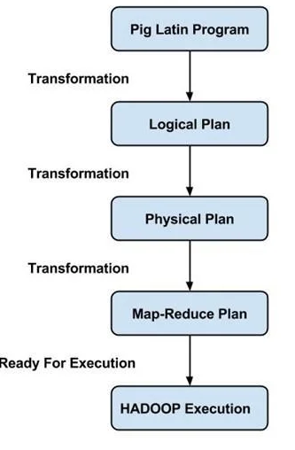
Pig Architecture
A Pig Latin program consists of a series of operations or transformations which are applied to the input data to produce output.
These operations describe a data flow which is translated into an executable representation, by Hadoop Pig execution environment. Underneath, results of these transformations are series of MapReduce jobs which a programmer is unaware of.
Pig in Hadoop allows the programmer to focus on data rather than the nature of execution.

Slide 123
Apache Pig Tutorial: Twitter Case Study
Twitter adopted Apache Pig.
Twitter’s data was growing at an accelerating rate (i.e. 10 TB data/day). Thus, Twitter decided to move the archived data to HDFS and adopt Hadoop for extracting the business values out of it.
Their major aim was to analyse data stored in Hadoop to come up with the following insights on a daily, weekly or monthly basis.

Slide 124
Counting operations:
How many requests twitter serve in a day?
What is the average latency of the requests?
How many searches happens each day on Twitter?
How many unique queries are received?
How many unique users come to visit?
What is the geographic distribution of the users?
Correlating Big Data:
How usage differs for mobile users?
Cohort analysis: analyzing data by categorizing user, based on their behavior.
What goes wrong while site problem occurs?
Which features user often uses?
Search correction and search suggestions.
Research on Big Data & produce better outcomes like:
What can Twitter analysis about users from their tweets?
Who follows whom and on what basis?
What is the ratio of the follower to following?
What is the reputation of the user?

Slide 125
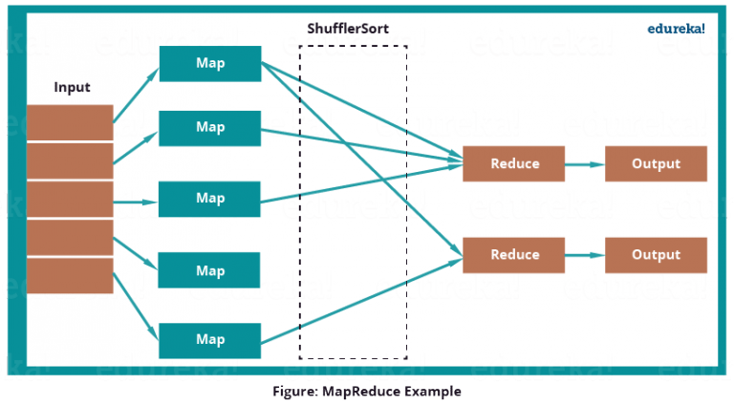
Analyse how many tweets are stored per user, in the given tweet table?

Slide 126
MapReduce program first inputs the key as rows and sends the tweet table information to mapper function.
Then the Mapper function will select the user id and associate unit value (i.e. 1) to every user id.
The Shuffle function will sort same user ids together.
At last, Reduce function will add all the number of tweets together belonging to same user.
The output will be user id, combined with user name and the number of tweets per user.

Slide 127
Twitter moved to Apache Pig for analysis. Now, joining data sets, grouping them, sorting them and retrieving data becomes easier and simpler
Twitter used Apache Pig to analyse their large data set.
Twitter had both semi-structured data like Twitter Apache logs, Twitter search logs, Twitter MySQL query logs, application logs and structured data like tweets, users, block notifications, phones, favorites, saved searches, re-tweets, authentications, SMS usage, user followings, etc. which can be easily processed by Apache Pig.

Slide 128
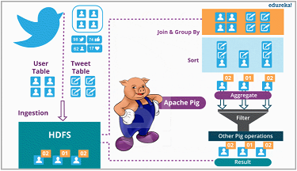

Slide 129
Twitter dumps all its archived data on HDFS.
It has two tables i.e. user data and tweets data.
User data contains information about the users like username, followers, followings, number of tweets etc.
Tweet data contains tweet, its owner, number of re-tweets, number of likes etc.
twitter uses this data to analyse their customer’s behaviours and improve their past experiences.

Slide 130
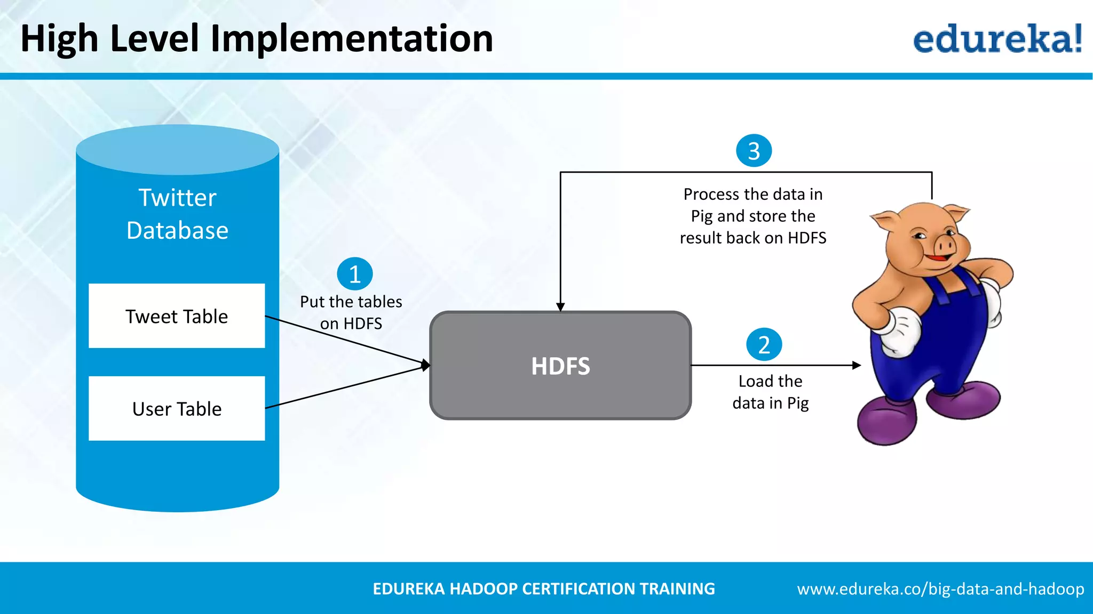
High level Implementation

Slide 131
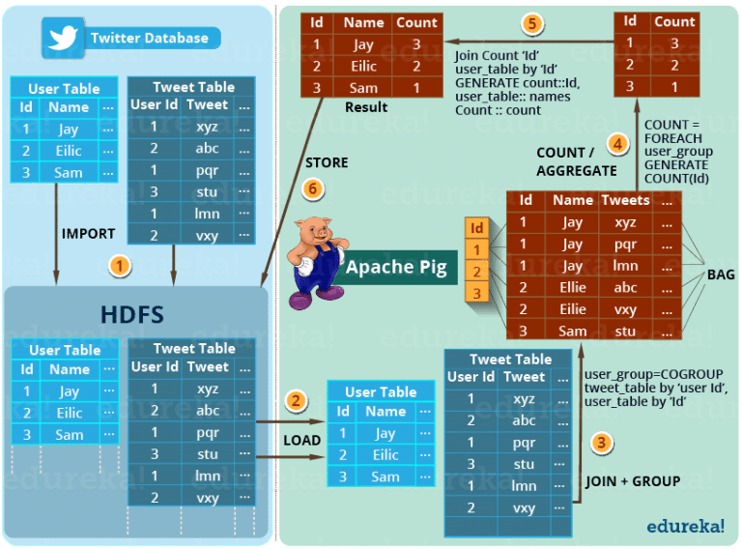

Slide 132
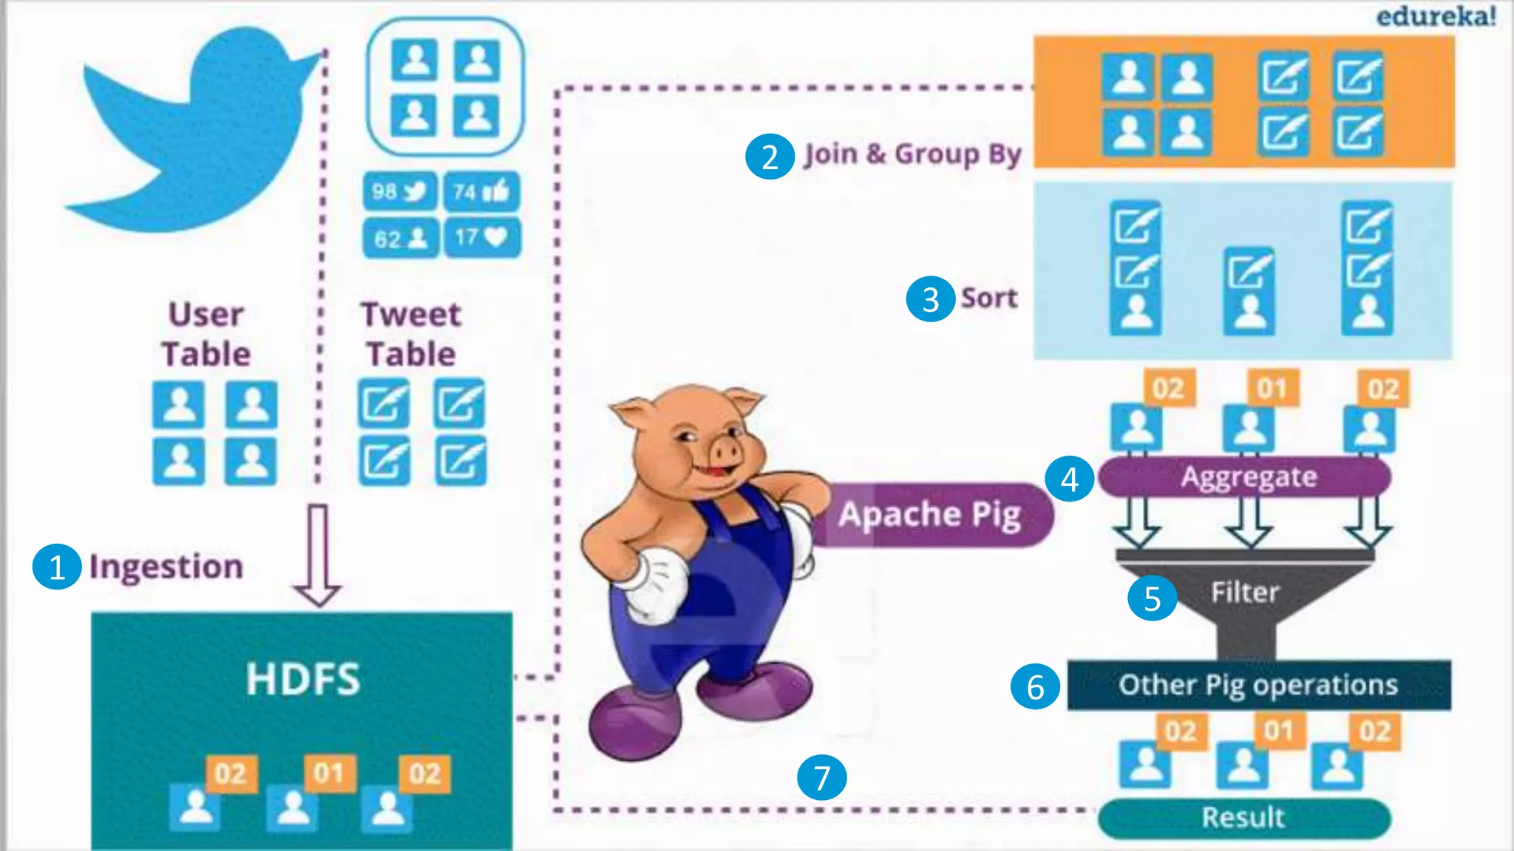

Slide 133
The step by step solution of this problem is shown in the above image.
STEP 1– First of all, twitter imports the twitter tables (i.e. user table and tweet table) into the HDFS.
STEP 2– Then Apache Pig loads (LOAD) the tables into Apache Pig framework.
STEP 3– Then it joins and groups the tweet tables and user table using COGROUP command .
This results in the inner Bag Data type.
Example of Inner bags produced
(1,{(1,Jay,xyz),(1,Jay,pqr),(1,Jay,lmn)})
(2,{(2,Ellie,abc),(2,Ellie,vxy)})
(3, {(3,Sam,stu)})

Slide 134
STEP 4– Then the tweets are counted according to the users using COUNT command. So, that the total number of tweets per user can be easily calculated.
Example of tuple produced as (id, tweet count)
(1, 3)
(2, 2)
(3, 1)
STEP 5– At last the result is joined with user table to extract the user name with produced result.
Example of tuple produced as (id, name, tweet count
(1, Jay, 3)
(2, Ellie, 2)
(3, Sam, 1)
STEP 6– Finally, this result is stored back in the HDFS.

Slide 135
STEP 6– Finally, this result is stored back in the HDFS.
Pig is not only limited to this operation. It can perform various other operations which I mentioned earlier in this use case.
These insights helps Twitter to perform sentiment analysis and develop machine learning algorithms based on the user behaviors and patterns.
Now, after knowing the Twitter case study, in this Apache Pig tutorial, let us take a deep dive and understand the architecture of Apache Pig and Pig Latin’s data model. This will help us understand how pig works internally. Apache Pig draws its strength from its architecture.

Slide 136
Apache Pig case study : New York Vehicle Collisions
Download data set in CSV format from New York city open data source.
Upload the CSV to HDFS . Let us assume it is uploaded to the path “/user/nitinguptabciit3123/pig/nyc_collission/NYPD_Motor_Vehicle_Collisions.csv”
Start pig console and execute below commands

Slide 137
Load collissions list from HDFS
collissions_list = LOAD ‘/user/nitinguptabciit3123/pig/nyc_collission/NYPD_Motor_Vehicle_Collisions.csv’ USING PigStorage(‘,’) AS (date:chararray, time:chararray, borough:chararray, zipcode:chararray, latitude:chararray, longtitude:chararray, location:chararray, onStreetName:chararray, crossStreetName:chararray, offStreetName:chararray, numberOfPersonsInjured:int, numberOfPersonsKilled:int, numberOfPedestriansInjured:int, numberOfPedestriansKilled:int, numberOfCyclistInjured:int, numberOfCyclistKilled:int, numberOfMotoristInjured:int, numberOfMotoristKilled:int, contributingFactorVehicle1:chararray, contributingFactorVehicle2:chararray, contributingFactorVehicle3:chararray, contributingFactorVehicle4:chararray, contributingFactorVehicle5:chararray);

Slide 138
Sort collisions list by borough
sorted_by_borough = ORDER collissions_list BY borough asc;
Find number of collisions per borough
Group by borough
group_by_borough = GROUP sorted_by_borough BY borough;
2. Find count
total_collissions_per_borough = FOREACH group_by_borough GENERATE group, COUNT(sorted_by_borough);
3.

Slide 139
Dump the result
/*
DUMP total_collissions_per_borough;
(0,1)
(BRONX,129714)
(QUEENS,251493)
(BOROUGH,1)
(BROOKLYN,295529)
(MANHATTAN,237097)
(STATEN ISLAND,43497)
(,394647)
*/

Slide 140
Find number of collisions per date
Group by date
group_by_date = GROUP sorted_by_borough BY date;
2. Find count
total_collissions_per_date = FOREACH group_by_date GENERATE group, COUNT(sorted_by_borough);
3. Dump result
DUMP total_collissions_per_date

